Slide 1
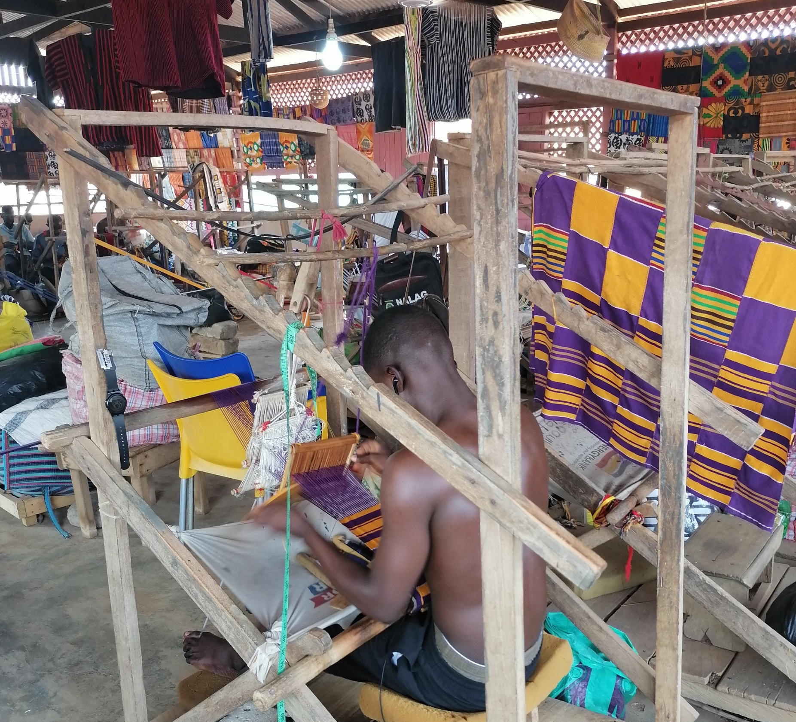

DIGIWEAVE: YOUTH WEAVERS EMPOWERMENT PROGRAM
BY ELFREDA-ANN NERQUAYE-TETTEH

Slide 2
INTRODUCTION
Goal:
To provide essential digital and entrepreneurial skills to the youth involved in kente production in Bonwire
Objectives:
To develop a training programme for weavers, sewers and sellers for digital and entrepreneurial training in the community.
To equip 100 kente youth weavers with fundamental digital and entrepreneurial skills to enhance creativity, productivity, marketing and overall efficiency in kente production

Slide 3

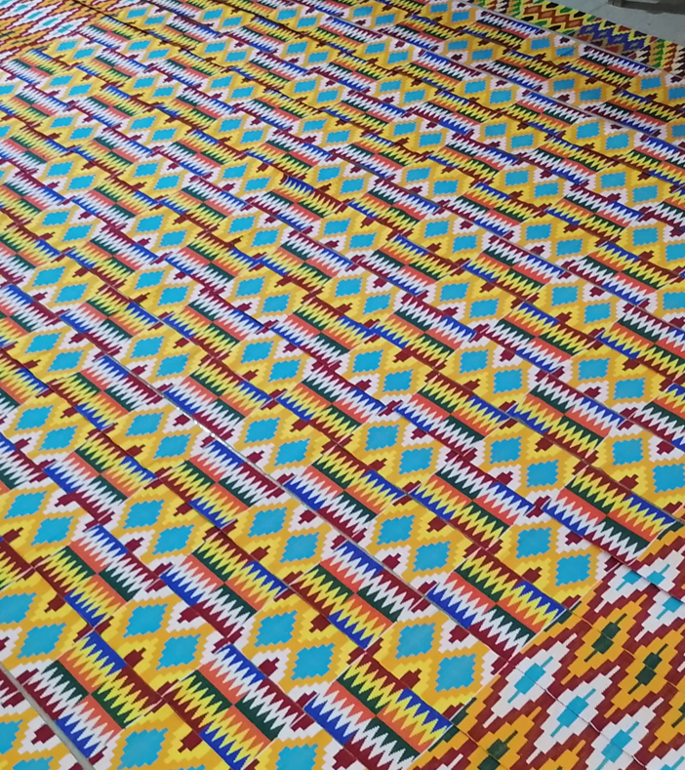

WHY KENTE WEAVERS
The production of Kente is an ancient practice and should have developed significantly over the years.
However, the kente weaving industry in Bonwire faces a number of challenges that has slowed down its progress leading to the decline of the industry and a lack of development in the area (King et al., 2024).
According to Meena et al. (2023) the weaving/textile industry is likely to interact with digitization and technology within the next decade.
We intend to take advantage of this.

Slide 4

OUR VISION
Envisioned impact on youth weavers
Digital Skills
Entrepreneurial Skills
Enhanced Digital Literacy
Enhanced efficiency of design process
Increased product reach
Enhanced economic opportunities
Fostered creativity and innovation
Increased resilience
Community Empowerment

Slide 5

Program Details: Digital Skills
Introduction to Digital Literacy: Basic computer skills, internet usage, and digital tool relevant to weaving (Adobe Photoshop and Illustrator).
Graphic Design Basics: Introduction to graphic design software for branding.
Online Presence: Building and managing online portfolios, social media presence, and e-commerce platforms.

Slide 6

Program Details: Entrepreneurial Training
Marketing Strategies: Utilizing digital marketing tools for promoting handcrafted products, Social-Media Marketing
Financial Literacy: Budgeting, pricing strategies, and financial management.
Networking skills: Building and managing relationships with potential vendors and customers.

Slide 7

Program Details: Interactive Learning:
Industry Expert Sessions: Inviting experienced kente entrepreneurs and industry professionals to share insights and experiences.
Hands-On Workshops: Practical sessions on product development, and quality control.

Slide 8

Program Details: Access to Resources
Digital Labs: Providing access to computer labs equipped with necessary software and internet connectivity.

Slide 9

Program Details: Program Duration
The program will run for a duration of 13 weeks, with a combination of practical activities, workshops and training sessions.

Slide 10
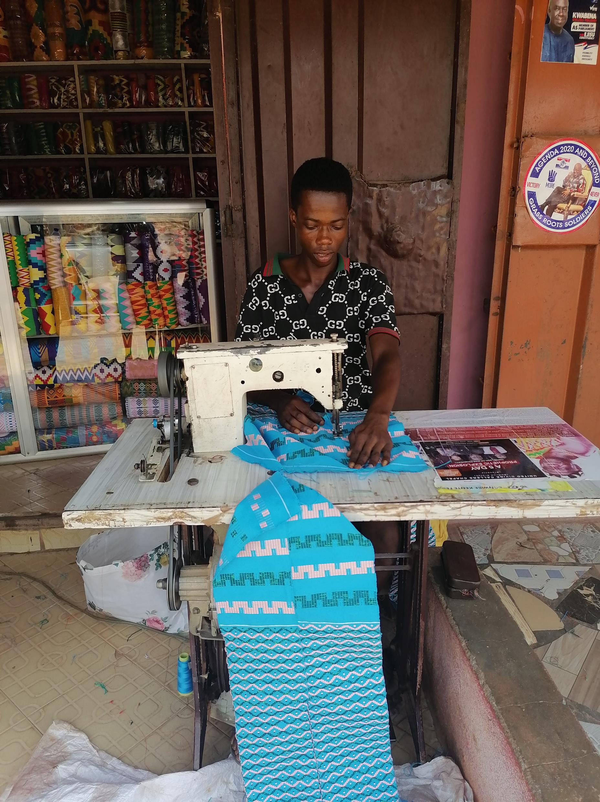
Program Details:Target Participants
Youth weavers aged 18-30 in the Bonwire with a passion for weaving and a desire to enhance their digital and entrepreneurial skills.

Slide 11
Program Outcome
Upon completion of the program, participants will have acquired essential digital and entrepreneurial skills, developed a business plan, established an online presence, developed digital and social marketing strategies

Slide 12

Evaluation
Regular assessments and feedback sessions will be conducted to evaluate participants' progress and ensure the program's effectiveness.

Slide 13
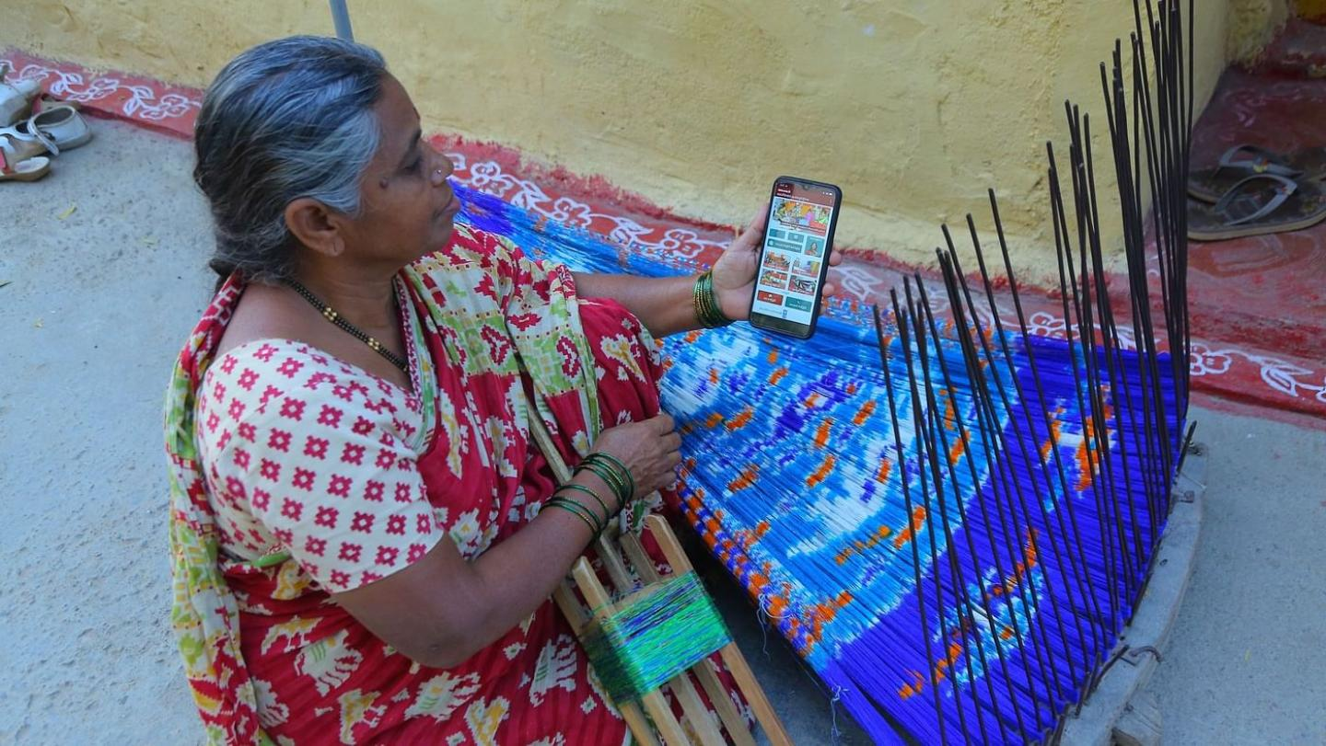
Success Stories
Case Study: Digital entrepreneurship for weavers in India during COVID-19
Feedback from participants:
Marginal increases in their monthly income after the training
Wider audiences reach
Increased sales
Source: https://www.col.org/news/digital-entrepreneurship-for-weavers-in-india-during-covid-19/

Slide 14

Thank You

